Slide 1
Lectures 09 – Processors: An overview
2017.09.11
Details create the big picture.
– Sanford Weill

Slide 2
Assignment for 2017.09.11
Lab 03 – starts this week
HW 03 due Thursday
Read textbook chapter 3
Review your Blackboard scores
Should see iClicker scores for Sessions 1 thru 6
If missing iClicker scores, email gba@purdue.edu by noon Friday, 9/15 so we can diagnose and fix
Lab and HW scores will be appearing gradually

Slide 3
Components of a computer
Hardware: Digital logic (chapter 2)
Gates
Combinatorial and sequential circuits
Adders, decoders, mux/demux, latch, flip-flops, registers
Data types: Representations for character, integer, and floating point (chapter 3)
Software: Instructions for what to compute
Big prize: Automation

Slide 4
Automation
User has an App model:
Start App [software]
User provides input (optional)
User gets result(s)
Need
Hardware to run the App
App software in a form that the hardware can access without user assistance
Compare with Lab 02, counting with Clock 4

Slide 5
Key idea: store program in memory
Registers store bit strings
Bit strings can be interpreted as char, int, float, etc
Let bit strings be interpreted as instructions
Now it is clear that a program can be pre-stored in a computer so that when a user wants a computation performed all that is needed is any required data input
Hardware that stores bits is memory

Slide 6
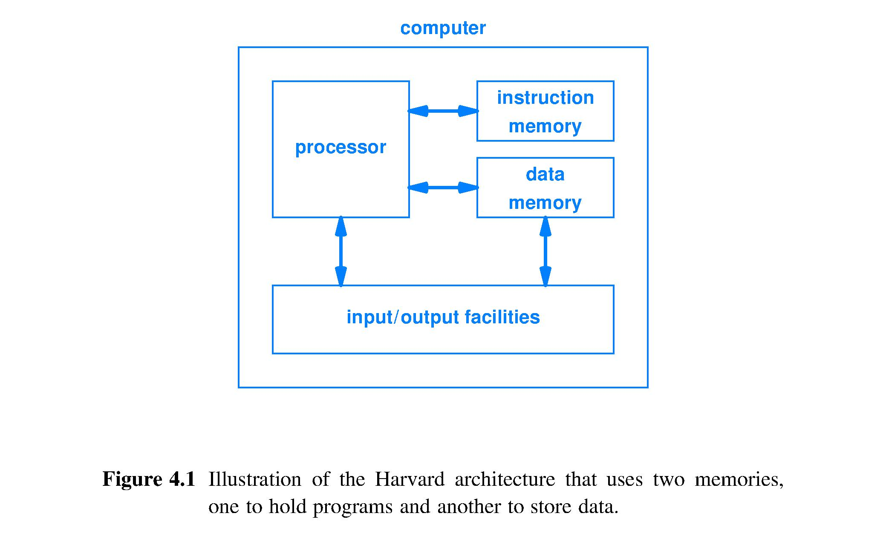
Harvard architecture
Idea by Howard Aiken, Harvard physicist, to IBM Nov. 1937
Built by IBM in Endicott, NY and delivered to Harvard in Feb. 1944 as the Mark 1 computer
Has separate memories for program (instructions) and data
Input/output (I/O) to connect to the world
Processor to carry out the computations

Slide 7
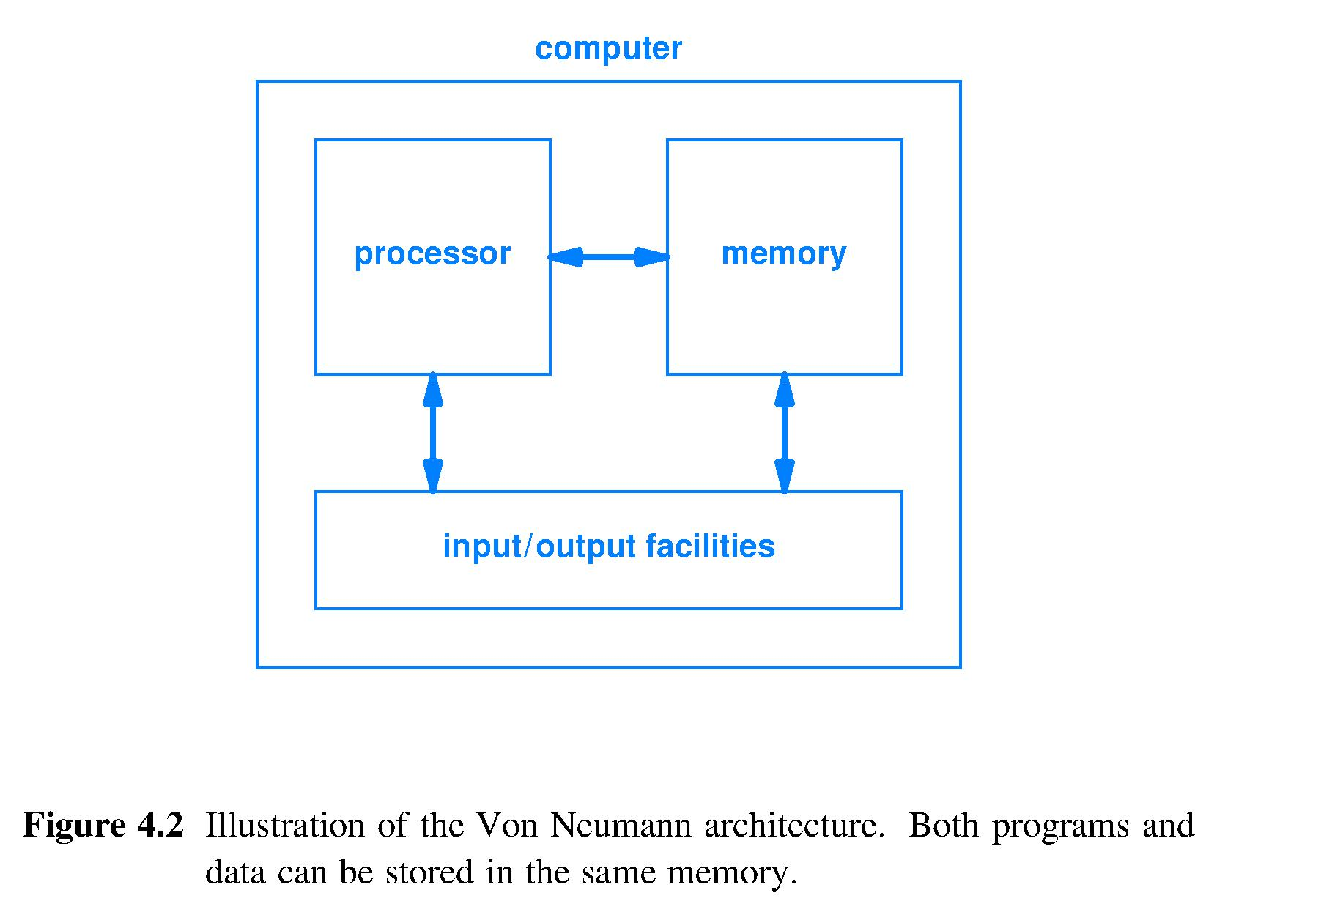
(John) Von Neumann architecture
Developed during his June 1945 train ride from Philadelphia to Los Alamos, NM
He had programmed Mark 1 in August 1944
One memory for both data and program
Same I/O, same processor as Aiken’s “Harvard” design
Notes:
Von Neumann clearly better at social media than Aiken (Harvard vs Von Neumann architectures)

Slide 8
Comparison of architectures
Harvard pro
Can optimize one memory for storing data, other for storing program
Can access data and program simultaneously
Harvard con
Less flexible, memory is physically partitioned
Von Neumann pro
Cheaper: each $ spent on memory helps store either data or program
Less secure: hardware cannot distinguish between program instructions and data values

Slide 9
Range of processor capabilities
Not programmable by user
Fixed logic processor – circuit is built (“hardwired”) for one function, e.g., traffic signal sequencer
Selectable logic processor – user can select from multiple hardwired functions, e.g., car with Econo and Sport modes for car’s automatic transmission
Parameterized logic processor – computes fixed function on variable use input, e.g., programmable video recorder
Programmable by user: programmable logic processor, e.g., laptop computer

Slide 10
Hierarchical processor structure
A programmable logic processor is often called the CPU (Central Processing Unit)
CPUs today usually comprise a collection of specialized computational engines
Graphics: accelerates the processing needed for video games; packed as a core, chip, or card
Pattern: accelerates searches and queries
AI: accelerates learning algorithms
Others

Slide 11
Processor categories
Processors used in a wide variety of roles
Coprocessor
Operate with and under control of another, more sophisticated processor
Implies separately packaged from controlling processor
Microcontroller
Used to indicate processor is dedicated to control of a physical system, e.g., electro-mechanical robot joint
Embedded system processor
Runs a smart gadget – router, phone, Blu-ray player
General-purpose processor
Heart of the personal computer, warehouse computer, smartphone

Slide 12
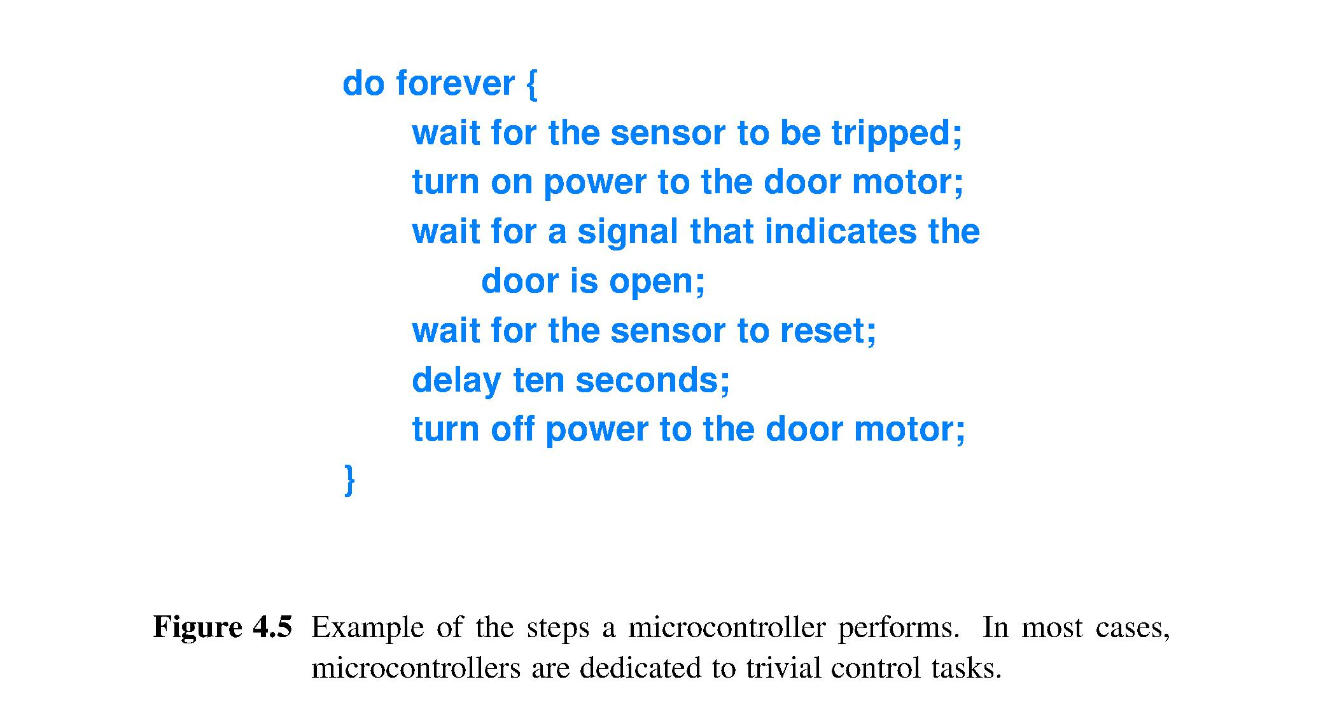
Example microcontroller application
Notes:
Not like most programs you wrote for CS180 and CS240. Is like the IRC Chat server that you wrote, Spring 2017

Slide 13
Stored programs
Some memories can be written to only once and then read from many times, called a Read-Only Memory (ROM)
Program for a microcontroller typically is stored in ROM, e.g., automobile engine control computer
Some ROM can be re-written, PROM (programmable ROM)
Embedded system processor often PROM to permit firmware upgrades

Slide 14
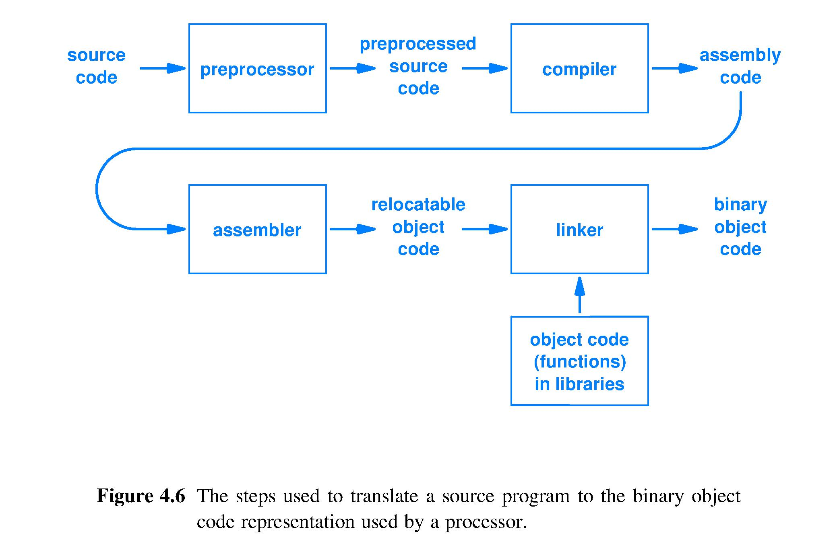
Program translation to machine code
Fetched from memory and executed within the processor

Slide 15
Processor Fetch-Execute algorithm
At highest level of abstraction, a processor circuit is designed to do this:
Repeat forever* {
FETCH – access the next program instruction
from the location where it is stored.
EXECUTE – perform the action(s) described by the instruction.
}
*Provided the hardware receives power and has not been instructed to halt
Notes:
Simple, single purpose computers often do not have a HALT instruction: Apple TV, a microwave oven controller, …
For these computer systems, to stop execution we must remove the power source.

Slide 16
Storing programs
Program is a sequence of instructions
Memory hardware can be designed as a sequence of locations
Program
Memory
Map instructions to memory locations

Slide 17
Reading an instruction
Each instruction stored in a memory location
Use multiplexer to point to one location; read instruction (copy its bits); send to processor
Program
Memory
Address
Instruction
Location
Instruction
Location
Instruction
Location
to Processor
Multiplexer
Instruction
Location
Location
Location

Slide 18
Storing programs
Sequence of addresses sent to multiplexer determines dynamic sequence of instructions
Determining address of next instruction is key
Program
Memory
Address
Instruction
Location
Instruction
Location
Instruction
Location
to Processor
Multiplexer
Instruction
Location
Location
Location

Slide 19
Clock rate and instruction rate
Fetch-Execute cycle of the processor circuit has a pace set by a clock signal
Number of clock cycles necessary to Fetch and Execute an instruction and the clock cycle frequency depends on
Speed of memory technology storing operand(s) and result (may be slower than processor circuit)
Specific instruction to be executed
Processor circuit design
History of instruction execution (current state)

